Slide 1
Red Team Engagement
Attack, Defense & Analysis of a Vulnerable Network
Notes:
-steph

Slide 2
Table of Contents
This presentation contains the following resources:
01
Network Topology & Critical Vulnerabilities
02
Exploits Used
Methods Used to Avoid Detection
03
Notes:
-steph

Slide 3
Network Topology & Critical Vulnerabilities
This section will assess the network topology used in this engagement followed by the critical vulnerabilities found on the Target 1 Virtual Machine when attacked using a Kali Linux Virtual Machine.
Notes:
-steph

Slide 4
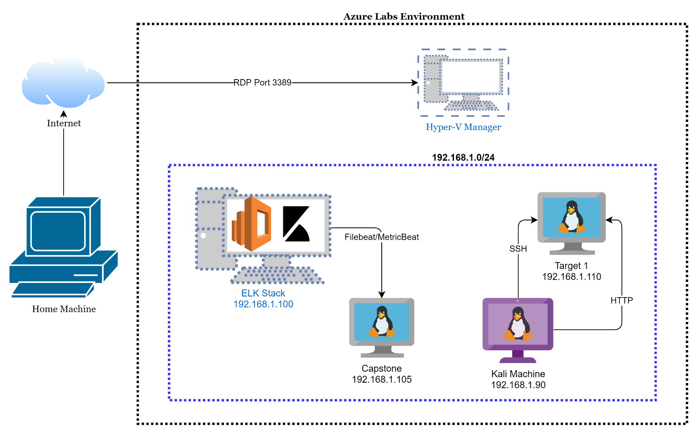
Network Topology
Network
Address Range:
192.168.1.0/24
Netmask:
Gateway: 192.168.1.1
Machines
IPv4: 192.168.1.90
OS: Debian Kali 5.4.0
Hostname: Kali
IPv4:192.168.1.110
OS: Debian GNU/Linux 8
Hostname: Target 1
IPv4: 192.168.1.105
OS: Ubuntu 18.04
Hostname: Capstone
IPv4: 192.168.1.100
OS: Ubuntu 18.04
Hostname: ELK
Notes:
-tom

Slide 5
Critical Vulnerabilities on Target 1:
Vulnerability | Description | Impact
WordPress User Enumeration | Utilized enumeration to gather user information for the web server | Allowed attacker to gather usernames to gain access to the web server
Weak Passwords | Was able to find passwords using John the Ripper and simple guessing to gain access to user logins | Allowed attacker to gain access to protected web directories
Unsalted User Password Hash | An unsalted user password hash makes it easier for a malicious actor to crack a users password. | Allows attackers to unhash passwords for easy password cracking
Misconfiguration of User Privileges | Used Stevens sudo access to escalate from Steven to root | Allowed privilege escalation to root
Notes:
-tom

Slide 6
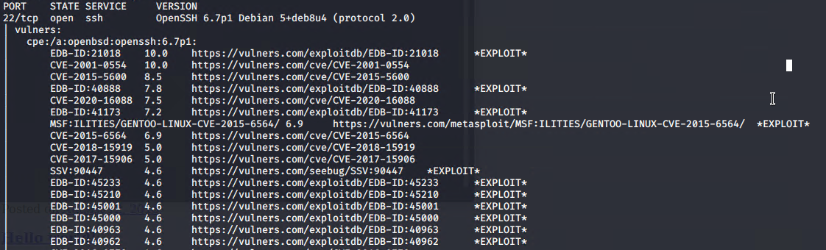
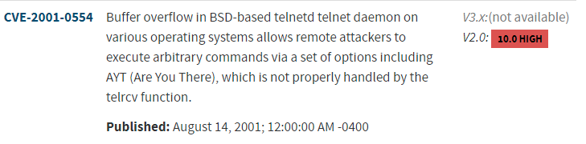
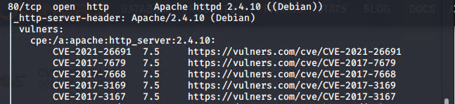
Screenshots of Critical Vulnerabilities:
Command ran to find vulnerabilities: nmap --script vulners -sV 192.168.1.110
https://nvd.nist.gov/vuln/search
Notes:
-tom

Slide 7
Exploits Used
This section will demonstrate the methods taken to execute the exploits on the Target 1 Virtual Machine.
Notes:
-ben

Slide 8
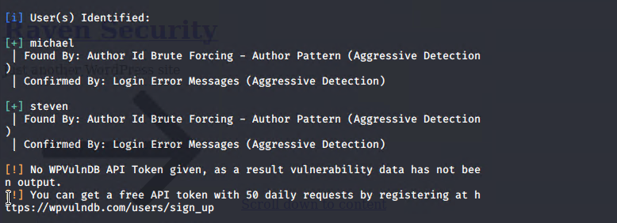
Exploitation: WordPress Enumeration
Summarize the following:
How did you exploit the vulnerability?
Used:
wpscan --url http://192.168.1.110/wordpress --enumerate u to enumerate the users on the web server.
What did the exploit achieve?
Gained critical information such as user information in order to SSH into server.
Notes:
-ben

Slide 9
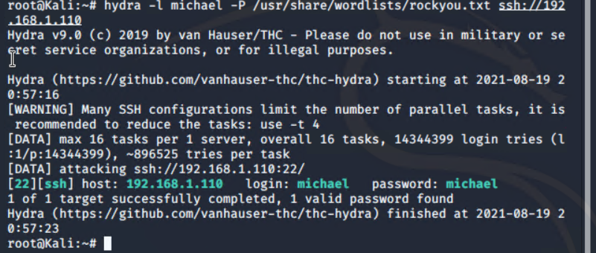
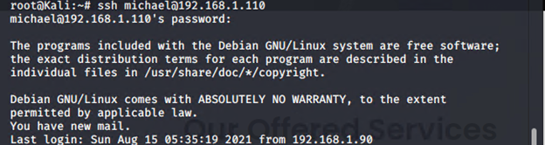
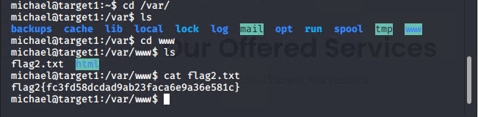
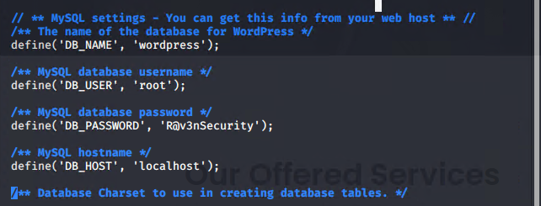
Exploitation: Weak Passwords
Summarize the following:
How did you exploit the vulnerability?
Used Manual Brute Force to guess the password
Username: Michael
Password: michael
NOTE: Use of Hydra tool can be used to brute force the password if it can’t be guessed easily.
Command syntax:
Hydra -l michael -P /usr/share/wordlists/rockyou.txt ssh://192.168.1.110
What did the exploit achieve?
Granted SSH access to Michael’s account to gather the MySQL database password in the wp-config.php file which was found in the wordpress folder, which was found in the html folder.
Notes:
-ben

Slide 10
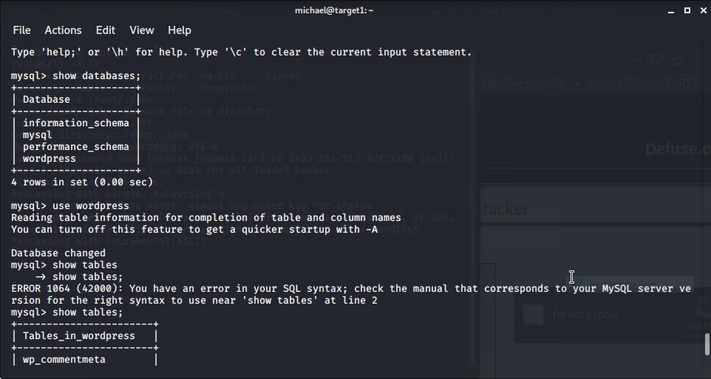
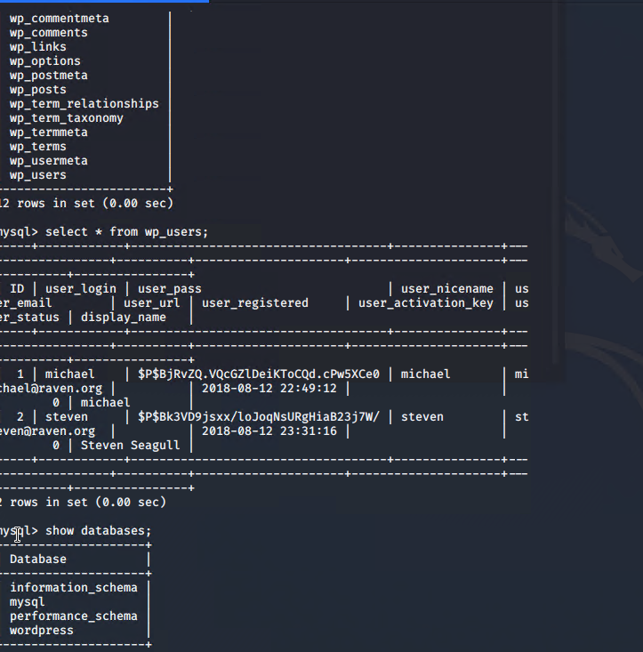
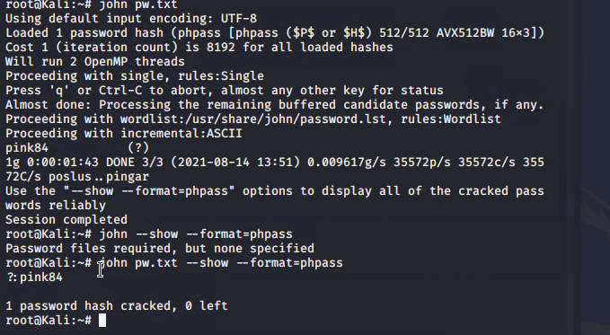
Exploitation: Unsalted User Password Hash
Summarize the following:
How did you exploit the vulnerability?
Once we had the password R@v3nSecurity from Michael's account we were able to use Mysql to find Steven’s unsalted password hash.
Mysql -u -root -p
Password: R@v3nSecurity
Show databases;
Use wordpress
Show tables;
Select * from wp_users
Used the John the Ripper tool to uncover the hashed password for Steven.
What did the exploit achieve?
Gave us Steven’s password to ssh into his account to access his information.
Notes:
-lauren

Slide 11
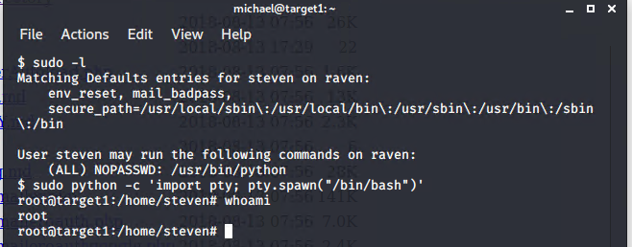
Exploitation: Misconfiguration of User Privileges
Summarize the following:
How did you exploit the vulnerability?
After gaining Access to Steven’s user account:
Used sudo -l to obtain the information Steven had root access for.
Used sudo python -c ‘import pty;pty.spawn(“/bin/bash”)’ to obtain root access
What did the exploit achieve?
Obtained access to the user shell to ultimately escalate up to root.
Ssh steven@192.168.1.110
Password: pink84
Sudo -l
Sudo python -c ‘import pty;pty.spawn(“/bin/bash”)’
Cd /root
Notes:
-lauren

Slide 12
Methods Used to Avoid Detection
This section will detail the alerts placed in Kibana and what methods can be used to attack the machine while mitigating detection.
Notes:
-lauren

Slide 13
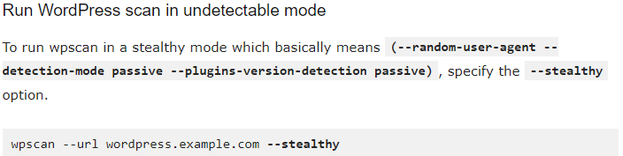
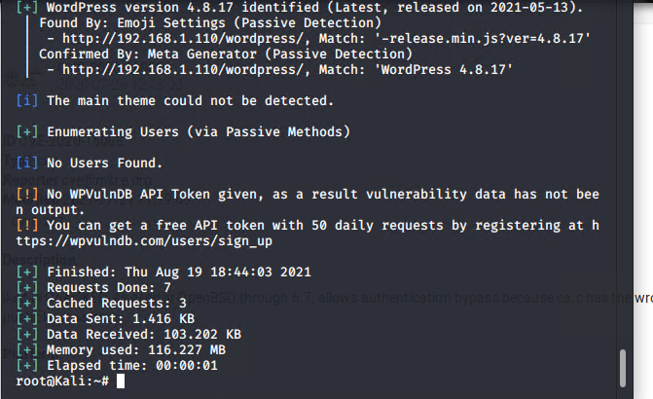
Stealth Exploitation of WordPress User Enumeration
Monitoring Overview
Which alerts detect this exploit?
In Kibana the alert is set :
WHEN sum() OF http.request.bytes OVER all documents IS ABOVE 3500 FOR THE LAST 1 minute
Which metrics do they measure?
http.request.bytes
Which thresholds do they fire at?
above 3500
Mitigating Detection
These types of alerts are resource intensive, most companies run them during off hours. It would be best to perform the attack during business hours in order to mitigate detection
Adding additional flags in order to take a more “stealthy” approach would limit the amount of http request bytes
Notes:
-austin

Slide 14


Stealth Exploitation of SSH
Monitoring Overview
Which alerts detect this exploit?
Alert in Kibana:
WHEN count() GROUPED OVER top 5 ‘http.response.status_code’ IS ABOVE 400 FOR THE LAST 5 minutes.
Which metrics do they measure?
http.response.status_code
Which thresholds do they fire at?
Above 400
Mitigating Detection
In order to limit the amount of error codes above 400, it would be critical to obtain the targeted user’s login credentials using methods that cannot be detected by an alert such as spear phishing or performing a man-in-the-middle attack.
Notes:
-austin

Slide 15
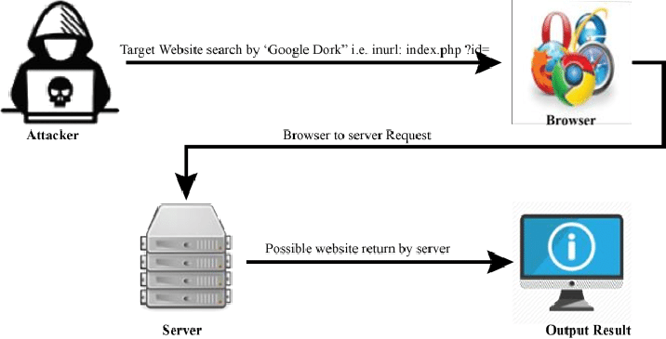
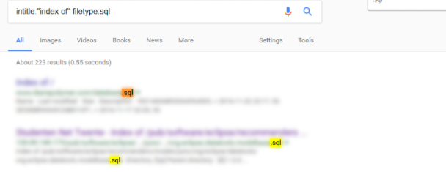
Stealth Exploitation of Directory Exploration
Monitoring Overview
Which alerts detect this exploit?
In Kibana the alert is set :
When max() OF system.process.cpu.total.pct OVER all documents IS ABOVE 0.5 FOR THE LAST 5 minutes
Which metrics do they measure?
system.process.cpu.total.pct
Which thresholds do they fire at?
CPU usage greater than equal to 0.5 (50%)
Mitigating Detection
Google Dorking could be used to find company employees (users), email addresses, vulnerable files and servers and even possibly passwords.
Notes:
-austin

Slide 16
The End
Austin Baxter, Ben Horsley, Lauren Williams, Steph Hoffman, & Tom Kuhn

